Slide 1
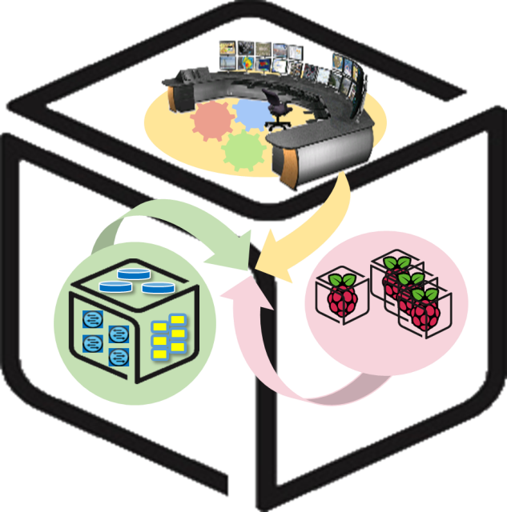
SmartX Labs for Computer Systems
Functions Lab v1.2
(2016, Spring)
NetCS Lab

Slide 2
History and Contributor of Functions Lab
(2016. 06. 01)
Version | Updated Date | Updated Contents | Contributor
v1.0 | 20160517 | 초고 완성 | 배 정 주
v1.1 | 20160601 | p20, p32 wordpress url을 yourip -> localhost로 변경 (헷갈림 방지) | 배 정 주
v1.2 | 20170510 | Docker image 버전 업데이트 및 스크린샷 수정 | 권 진 철

Slide 3
Functions Lab: Goal
Strength of Docker: Docker Image
Introduce Docker Hub + Searching and Getting Image from Docker Hub
Running 3 Tier (nginx-wordpress-mysql) Web Application
Understanding Docker basic network (--link option)

Slide 4
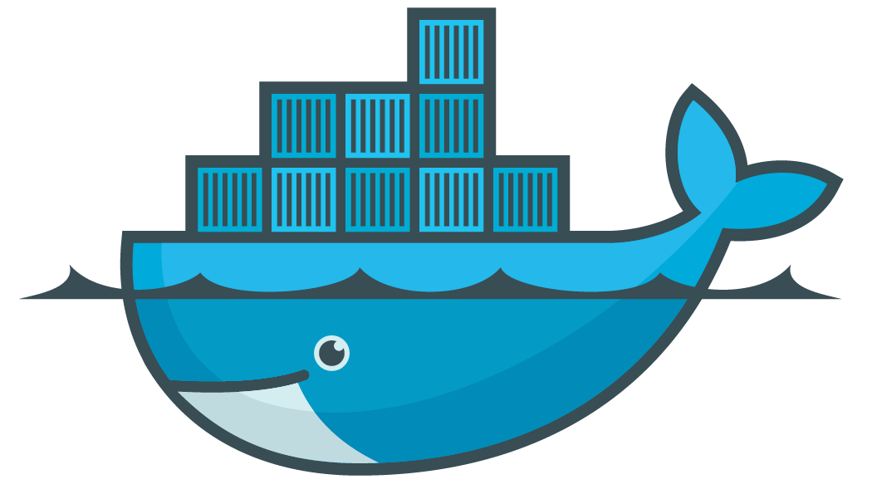





Functions Lab: Overall - One of 3-Tier example
Docker Hub

Slide 5
Functions Lab: Overall - Background knowledge of goal
We will running one of web application: Wordpress
This web application is consisted with 3 containers: nginx, wordpress, mysql
nginx
: A http server which has following features.
- Reverse proxying
- SSL TLS SNI support… and etc
Usually, It is compared by Apache.
wordpress
: It is web software to create website, blog, or application.
mysql
: Relational Database Management System(RDBMS)

Slide 6
Functions Lab: Overall - Scenario
Request:
ipaddress:8888
port: 8888
Request:
ipaddress[:80]/red
port: 9999
Request:
ipaddress[:80]/black
port: 8888

Slide 7
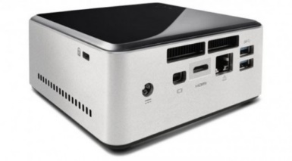
Prerequisite for Functions lab
Functions lab focus on (Docker container) functions of NUC
docker-engine (version: 1.10 or above)

Slide 8
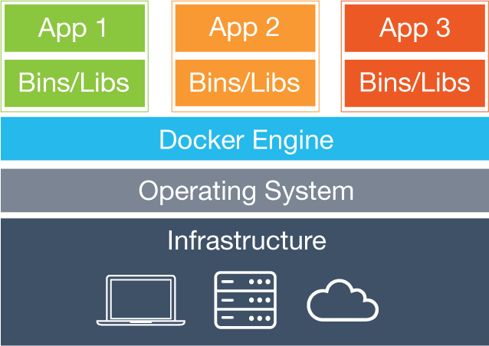
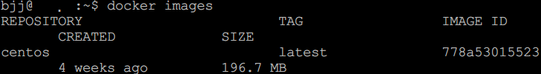
Docker Background Knowledge
- Reminder: Docker Image
Docker image: A file which contains status of Docker container.
Similar to snapshot of VM.
It can be branched and versioned…
Docker image can be shared easily.
(It is important feature of Docker.)
You can find Ubuntu image on your machine

Slide 9
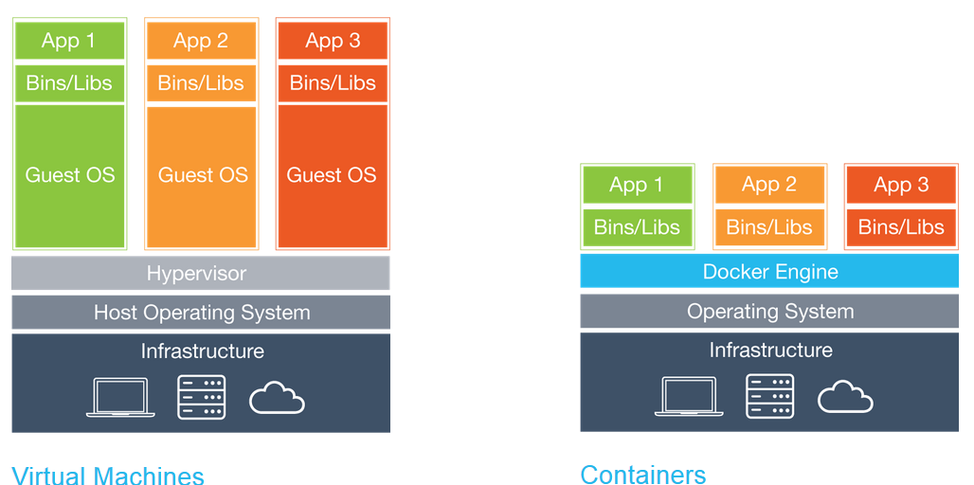
Docker Background Knowledge
- Reminder: Container restraint
Since container uses host kernel, OS of host should be Linux distribution.

Slide 10
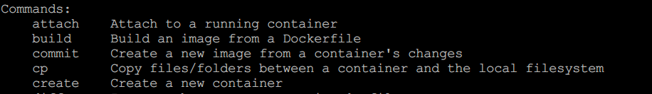
Docker Background Knowledge
- Why Docker image can be shared easily? (1)
Docker provides related commands!
This usage is similar to code management system. (e.g, svn, git)

Slide 11
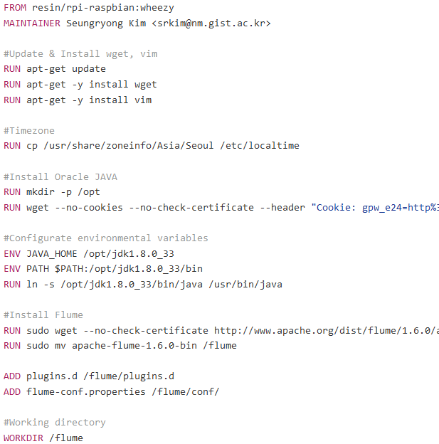
Docker Background Knowledge
- Why Docker image can be shared easily? (2)
Docker image is built by Dockerfile which is small text file.
That means sharing Docker image does not requires huge bandwidth (sometimes).

Slide 12
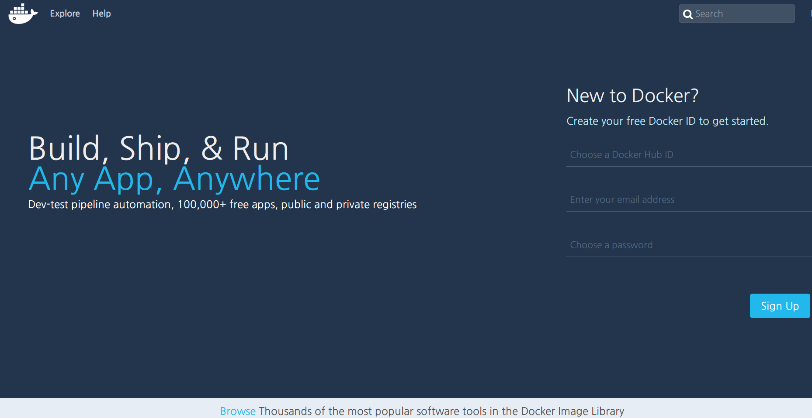
Getting Docker Image
- Public Docker Image Repository: Docker Hub (1)
https://hub.docker.com/

Slide 13

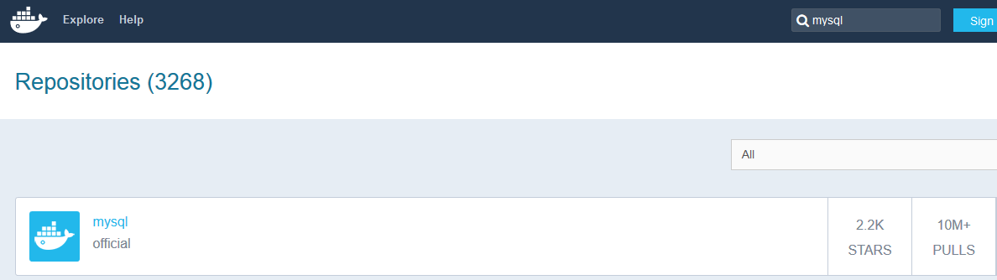
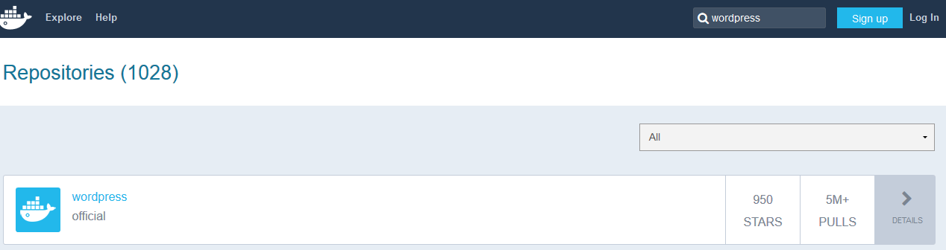
Getting Docker Image
- Public Docker Image Repository: Docker Hub (2)
You can easily find application image

Slide 14
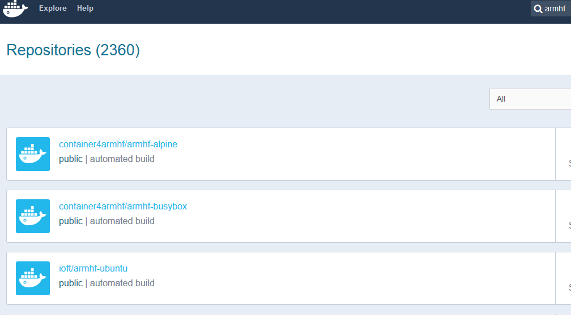
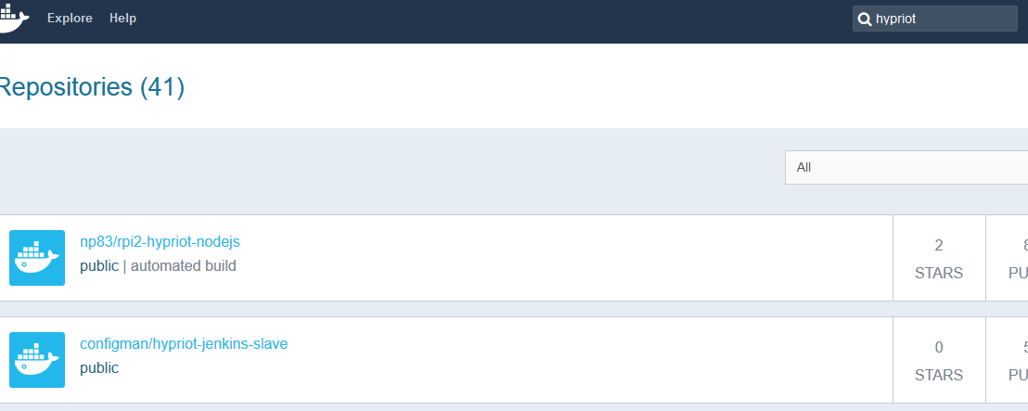
Getting Docker Image
- Be aware!
x86 based image can not run in Raspberry Pi!
If you want to use Docker image in RPi, you should find ARM based image!

Slide 15
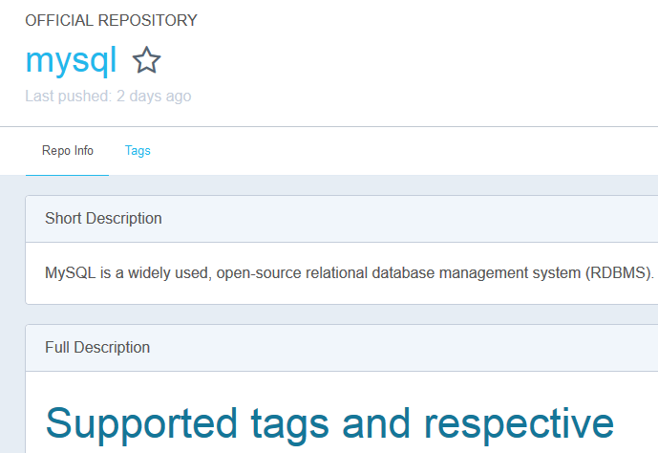

Getting Docker Image
- Public Docker Image Repository: Docker Hub (3)
Before using Docker image, you should read description.
It is very important because required option rely on image.

Slide 16
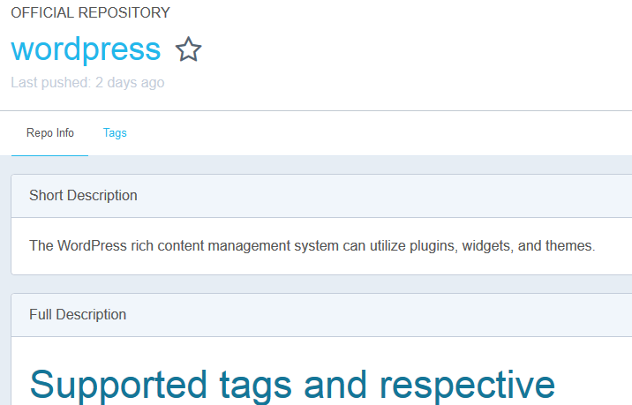
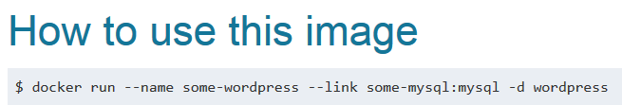
Getting Docker Image
- Public Docker Image Repository: Docker Hub (4)

Slide 17
Functions Lab: - Try: wordpress-mysql
Request:
ipaddress:8888
port: 8888
Request:
ipaddress[:80]/red
port: 9999
Request:
ipaddress[:80]/black
port: 8888

Slide 18
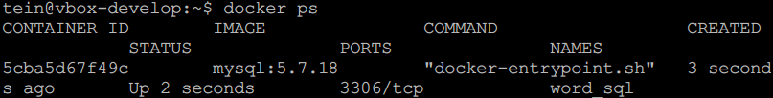
Running Web Application - Run mysql container
mkdir ~/sql
docker run --name word_sql -v /home/[username]/sql:/var/lib/mysql -e MYSQL_ROOT_PASSWORD=[password] -d mysql:5.7.18
Tag. Default is latest (Latest version)
docker ps

Slide 19
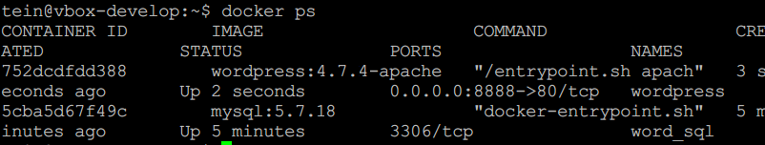
Running Web Application - Run wordpress container
docker run --name wordpress --link word_sql:mysql -p 8888:80 -d wordpress:4.7.4-apache
(Will be introduced)
docker ps

Slide 20
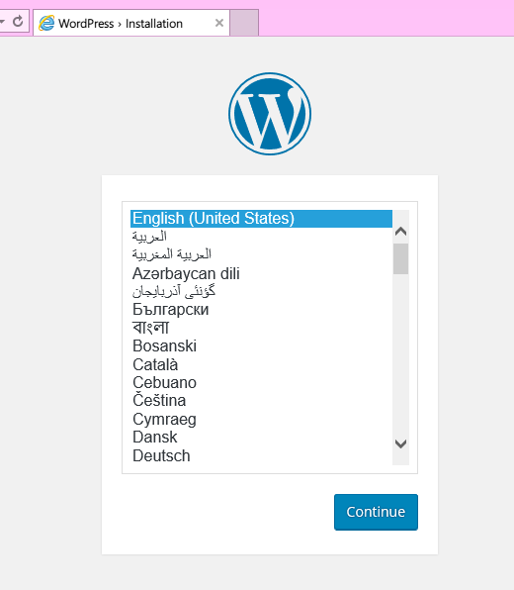
Running Web Application - Check wordpress!
http://localhost:8888
We typed just 2 line of commands
to running wordpress!
This is one of major Docker strength
:Easy deployment of software

Slide 21
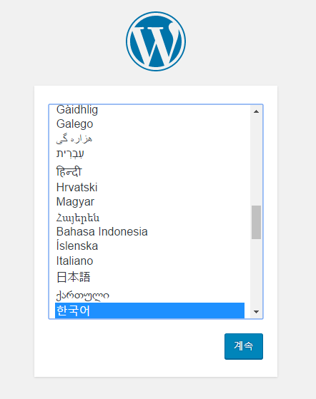
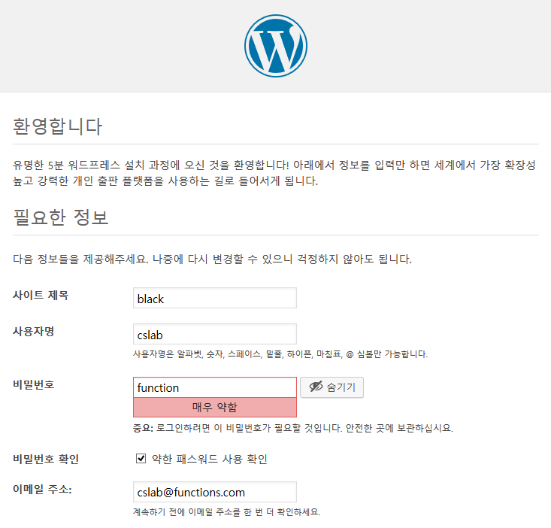

Running Web Application
- Default configuration: Wordpress

Slide 22
Running Web Application
- About --link option (1)
(In official docs..)
Docker also has a linking system that allows you to link multiple containers together and send connection information from one to another. When containers are linked, information about a source container can be sent to a recipient container. This allows the recipient to see selected data describing aspects of the source container.
Links allow containers to discover each other and securely transfer information about one container to another container. When you set up a link, you create a conduit between a source container and a recipient container.
Usage: --link <name or id>:alias
--link <name or id>
Naming container is important!

Slide 23
Running Web Application
- About --link option (2)
sudo docker inspect -f "{{ .HostConfig.Links }}" wordpress
You can see wordpress container is linked with mysql container.
Conduit which is made by --link option

Slide 24
Running Web Application
- About --link option (3)
(In official docs..)
Docker creates a secure tunnel between the containers that doesn’t need to expose any ports externally on the container.
That’s a big benefit of linking: we don’t need to expose the source container.
Review our commands: Creating mysql container
→ This container doesn’t expose any ports.
mkdir sql
sudo docker run --name word_sql -v /home/[username]/sql:/var/lib/mysql -e MYSQL_ROOT_PASSWORD=[password] -d mysql
Also we don’t need to type password of mysql when creating wordpress container
sudo docker run --name wordpress --link word_sql:mysql -p 80:80 -d wordpress

Slide 25
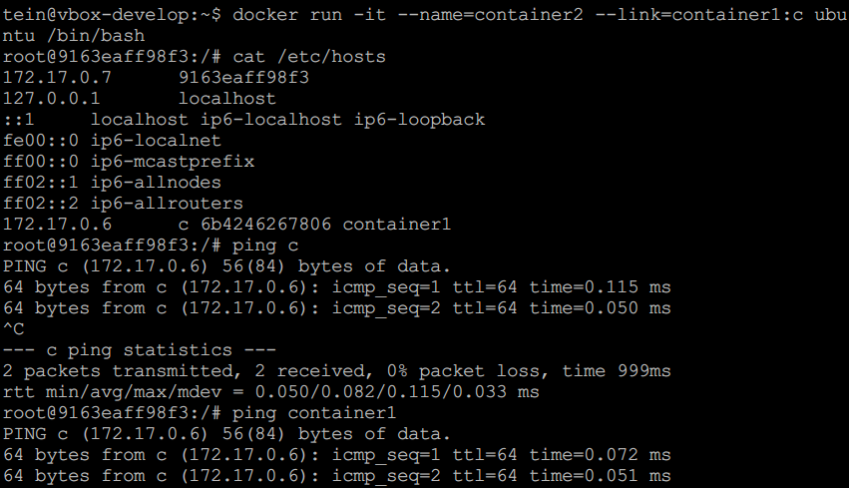
Running Web Application
- About --link option (4)
(In official docs..)
Functionality of this option is:
- Updating Environment variables
- Updating the /etc/hosts file

Slide 26
Functions Lab: - Try: nginx-wordpress-mysql
Request:
ipaddress:8888
port: 8888
Request:
ipaddress[:80]/red
port: 9999
Request:
ipaddress[:80]/black
port: 8888

Slide 27
Running Web Application
- Make another wordpress container set
Request:
ipaddress[:80]/red
port: 9999
Request:
ipaddress[:80]/black
port: 8888
mkdir ~/sql2
docker run --name word_sql2 -v /home/[username]/sql2:/var/lib/mysql -e MYSQL_ROOT_PASSWORD=[password] -d mysql:5.7.18
docker run --name wordpress2 --link word_sql2:mysql -p 9999:80 -d wordpress:4.7.4-apache

Slide 28
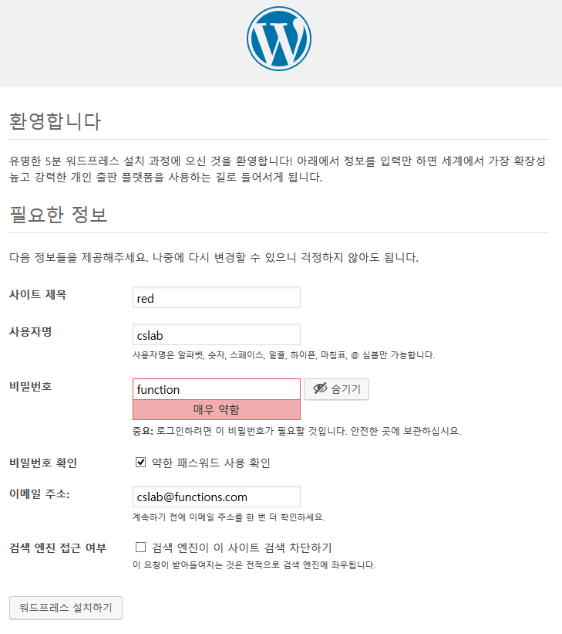

Running Web Application
- Default configuration: Wordpress

Slide 29
Running Web Application
- Current status
ip:8888
ip:9999

Slide 30
Running Web Application
- Make container for reverse proxy
docker run -it --name=nginx -p 80:80 ubuntu:16.04
Forwarding host_port:container_port

Slide 31
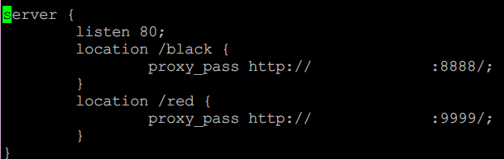
Running Web Application
- Setting reverse proxy
apt-get update
apt-get install nginx
apt-get install vim
cd /etc/nginx/sites-enabled
rm default
vi default
[your ip]
[your ip]
service nginx start

Slide 32
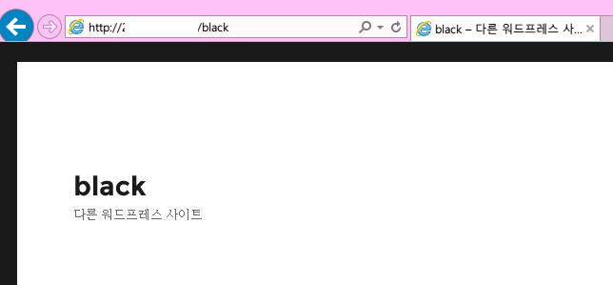
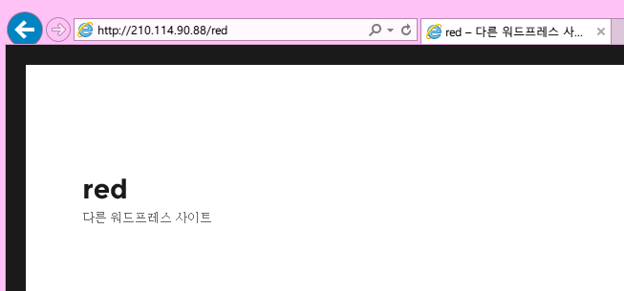
Running Web Application
- Setting reverse proxy
Try
http://localhost/black
http://localhost/red

Slide 33
Appendix
Control Tower: Docker Private Registry

Slide 34
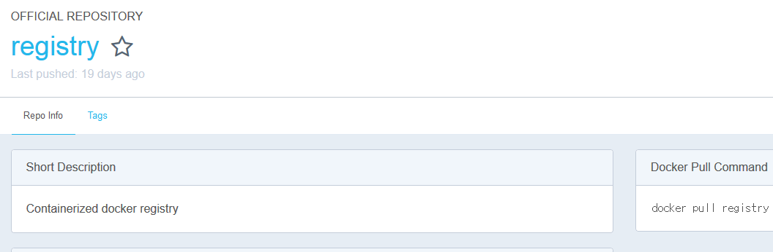
Docker Private Registry
- About
In previous slides, Docker image is operated and maintained likes source code (e.g svn, git…)
Also we used Docker public repository, Docker Hub. (which looks like github)
Surely, Docker also provides private repository: Registry.

Slide 35
Docker Private Registry
- How to use (1)
Deployment(In control tower):
docker run -d -p 5000:5000 --restart=always --name registry registry:2
--restart=always means this container is already running even Docker host rebooted.

Slide 36
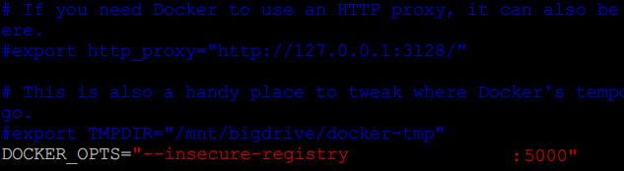
Docker Private Registry
- How to use (2)
You may configure insecure-registry options on NUC and Raspberry Pi
(Basic registry runs on insecure mode.)
Setting(In NUC and RPi):
sudo vi /etc/default/docker
DOCKER_OPTS=“--insecure-registry [control tower ip]:5000”
If any DOCKER_OPTS is already been, just add this phrase to end of OPTS.
sudo service docker restart

Slide 37
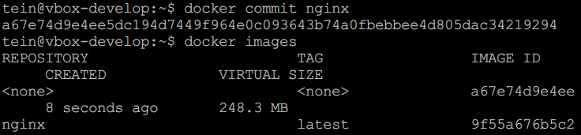
Docker Private Registry
- How to push and pull image (1)
In this time, we make a image of nginx container and push to registry
Making container image and push to registry (In NUC):
docker commit nginx
docker images

Slide 38
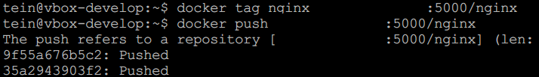

Docker Private Registry
- How to push and pull image (2)
Tagging image for pushing and push image
docker tag nginx [control tower ip]:5000/nginx
docker push [control tower ip]:5000/nginx
Check!
curl [control tower ip]:5000/v2/_catalog
You can find!

Slide 39
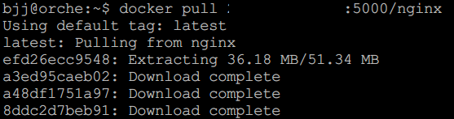
Docker Private Registry
- How to push and pull image (3)
Pulling(In other machines):
docker pull [control tower ip]:5000/nginx

Slide 40
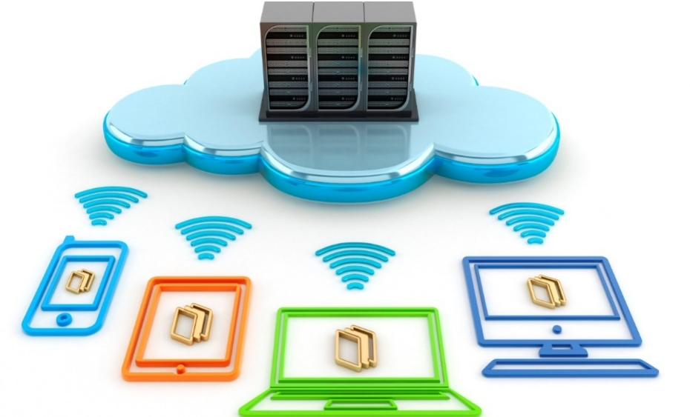
Thank You for
Your Attention
Any Questions?

